Slide 1
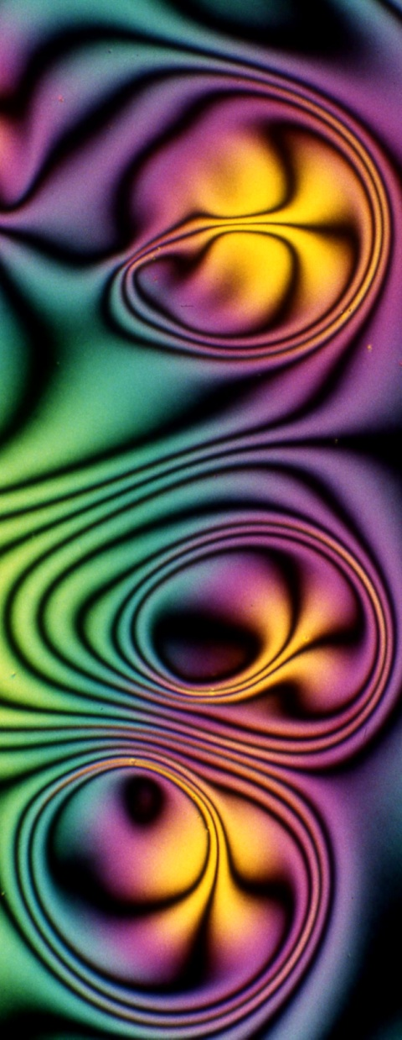
Developments in Electroactive Lens Technology for Vision Correction
Harry Milton, Anthony Van Heugten
eVision Smart Optics
Display Week
May 16th, 2019

Slide 2
Introduction to Liquid Crystal Lenses
Slide 1: Introduction to Liquid Crystal Lenses
Liquid crystal lenses are designed to change their focal length electronically
Can be turned on and off
Able to be switched between focal lengths
Why is this useful?
Imaging applications
Augmented reality applications
Vision correction
Electronic vision correction
Especially useful to correct presbyopia
Video taken using eVision liquid crystal lens

Slide 3
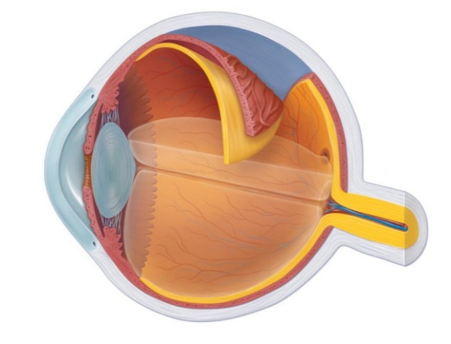
Introduction to Presbyopia Corrections
Slide 2: Introduction to Presbyopia Corrections
Presbyopia is the age related deterioration of the eye
Reduction of flexibility in the crystalline lens
Natural part of the aging process and affects all people over the age of 55
Current state of correction
Most common correction is the use of reading glasses
Correction is particular problematic for contact lens wearers.
Liquid crystal lenses show great potential for correcting presbyopia
Able to provide additional focal power when required
Analogous to putting on and removing a pair of reading glasses

Slide 4
Vision Correction using Liquid Crystal Lenses
Slide 3: Vision Correction using Liquid Crystal Lenses
Unique challenges when working with spectacle lenses and contact lenses
Contact Lenses
Required to be thin
(<300 micron)
Able to be placed on the eye
Compatible with existing contact lenses
Spectacle Lenses
Need to have large optical area
(25 mm upwards)
Off axis performance important
Able to be mounted into spectacle frames
Requirements for both devices:
Need to provide up to +3.00 D when activated
Optically inactive when turned off
Low voltage and power consumption

Slide 5
Liquid Crystal Contact Lenses
Slide 4: Liquid Crystal Contact Lenses
eVision liquid crystal contact lens utilizes diffractive optical design
Surface relief structure fabricated on polymer substrates
Liquid crystal index matched with substrate
6 mm optical zone
Lens has dimensions and curvature appropriate for contact lens use
Fabricated using ophthalmic materials
Radius of curvature to match the eye
Lens design has appropriate thickness for contact lens use
Lens prototype approximately 150 microns in thickness
Electro-optical layers provide electric potential to liquid crystal layer

Slide 6
Optimizing Contact Lens Optics
Slide 5: Optimizing Contact Lens Optics
When using single point diamond turning – size matters
Small diamond point is required to produce high quality diffractive structure
Used for molds and prototyping
However, small diamond points impact surface quality
Hybrid approach implemented to give the best of both worlds
VAN Photoalignment
Buffing process is problematic
Many issues solved by use of photoalignment in contact lens device
Exposure to polarizer UV light induces pretilt angle and ensures unidirectional switching
Significant increase in optical quality when switching to VAN photoalignment

Slide 7
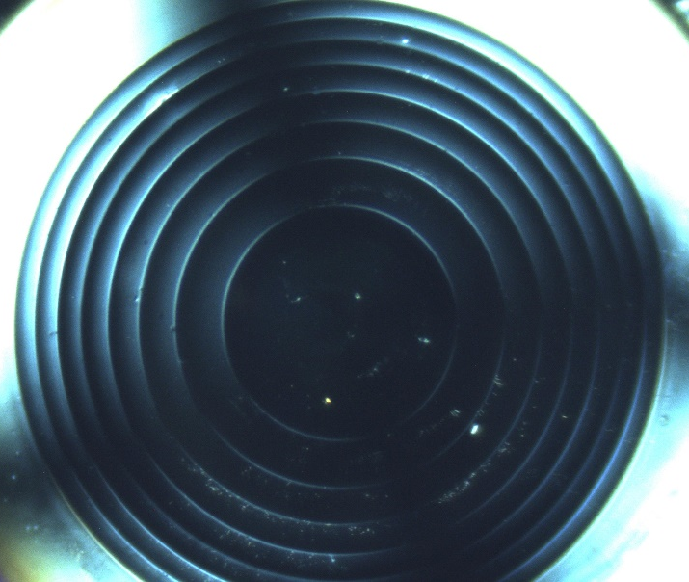
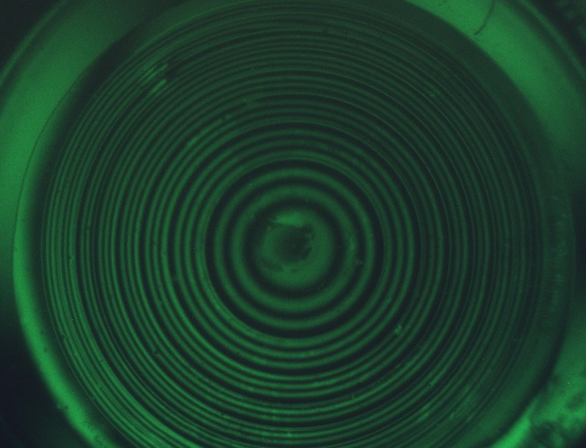
VAN Photoalignment
Slide 6: VAN Photoalignment
Off State On State

Slide 8
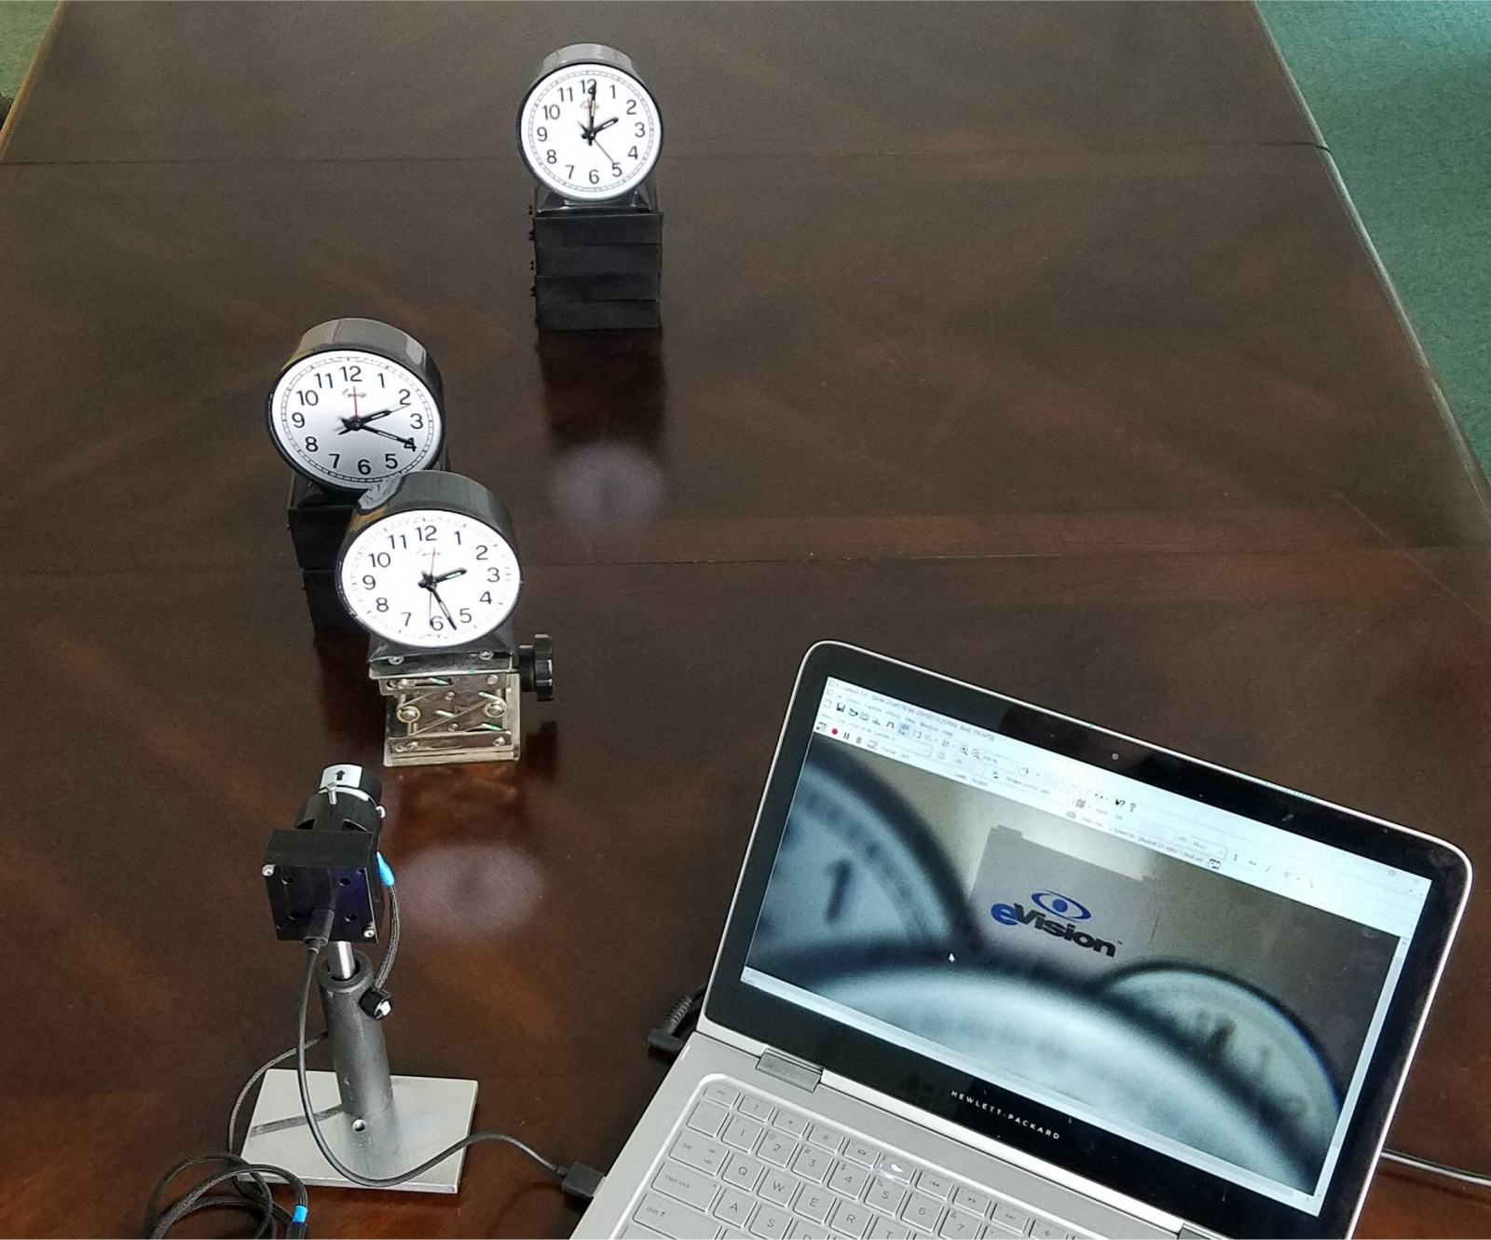
Contact Lens in Action
Slide 7: Contact Lens in Action

Slide 9
Contact Lens in Action
Slide 8: Contact Lens in Action

Slide 10
Contact Lens in Action
Slide 9: Contact Lens in Action

Slide 11
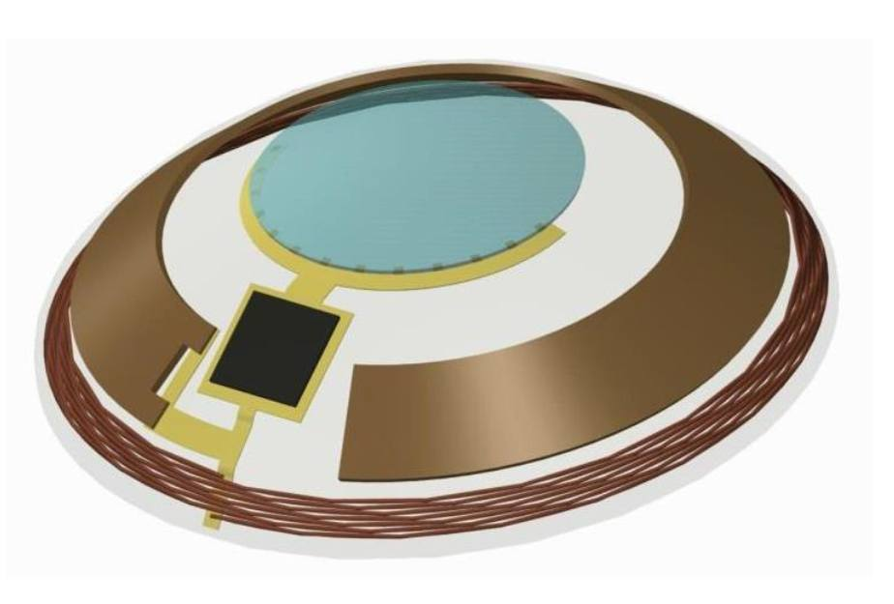
Contact Lens: Summary
Slide 10: Contact Lens: Summary
Four optical power states, for example:
0.00 D when unpowered for distance vision
+1.00 D for intermediate vision
+2.00 D for near-intermediate vision
+3.00 D for near vision
Other combinations or more if needed
Switching Speed: 50 ms
Electrical power consumption: <2 μW
Able to be controlled via Bluetooth and remote control
Cell phone and smart watch control developed
Electronics under development for self contained unit

Slide 12
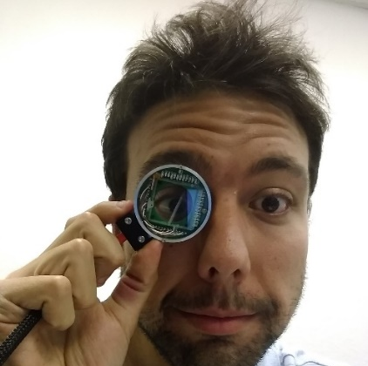
Liquid Crystal Spectacle Lenses
Slide 11: Liquid Crystal Spectacle Lenses
Two primary approaches:
Surface Relief
Similar technique to contact lens device
Can be indexed matched to other liquid crystal modes such as chiral nematic
Electrode Based
Uses flat substrates
Photolithography used to develop electronic components
Concentric ring electrodes are powered to product a gradient index optical device

Slide 13
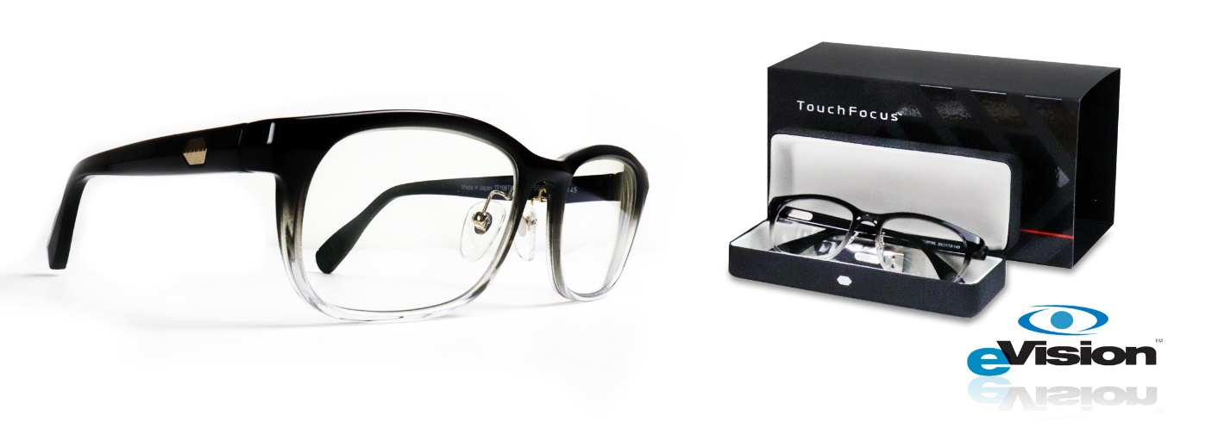
Surface Relief Spectacle Lenses
Slide 12: Surface Relief Spectacle Lenses
Single liquid crystal layer used with a diffractive structure
Short pitch chiral nematic used
Average liquid crystal refractive index observed – polarization insensitive
Electrical switching reduces refractive index and induces optical power
1st generation product able to provide additional +0.75 D when activated
Optical zone is approximately 2 cm by 1 cm
Next generation device to have higher power and larger optical zone
Currently used in TouchFocus™ spectacle lenses

Slide 14
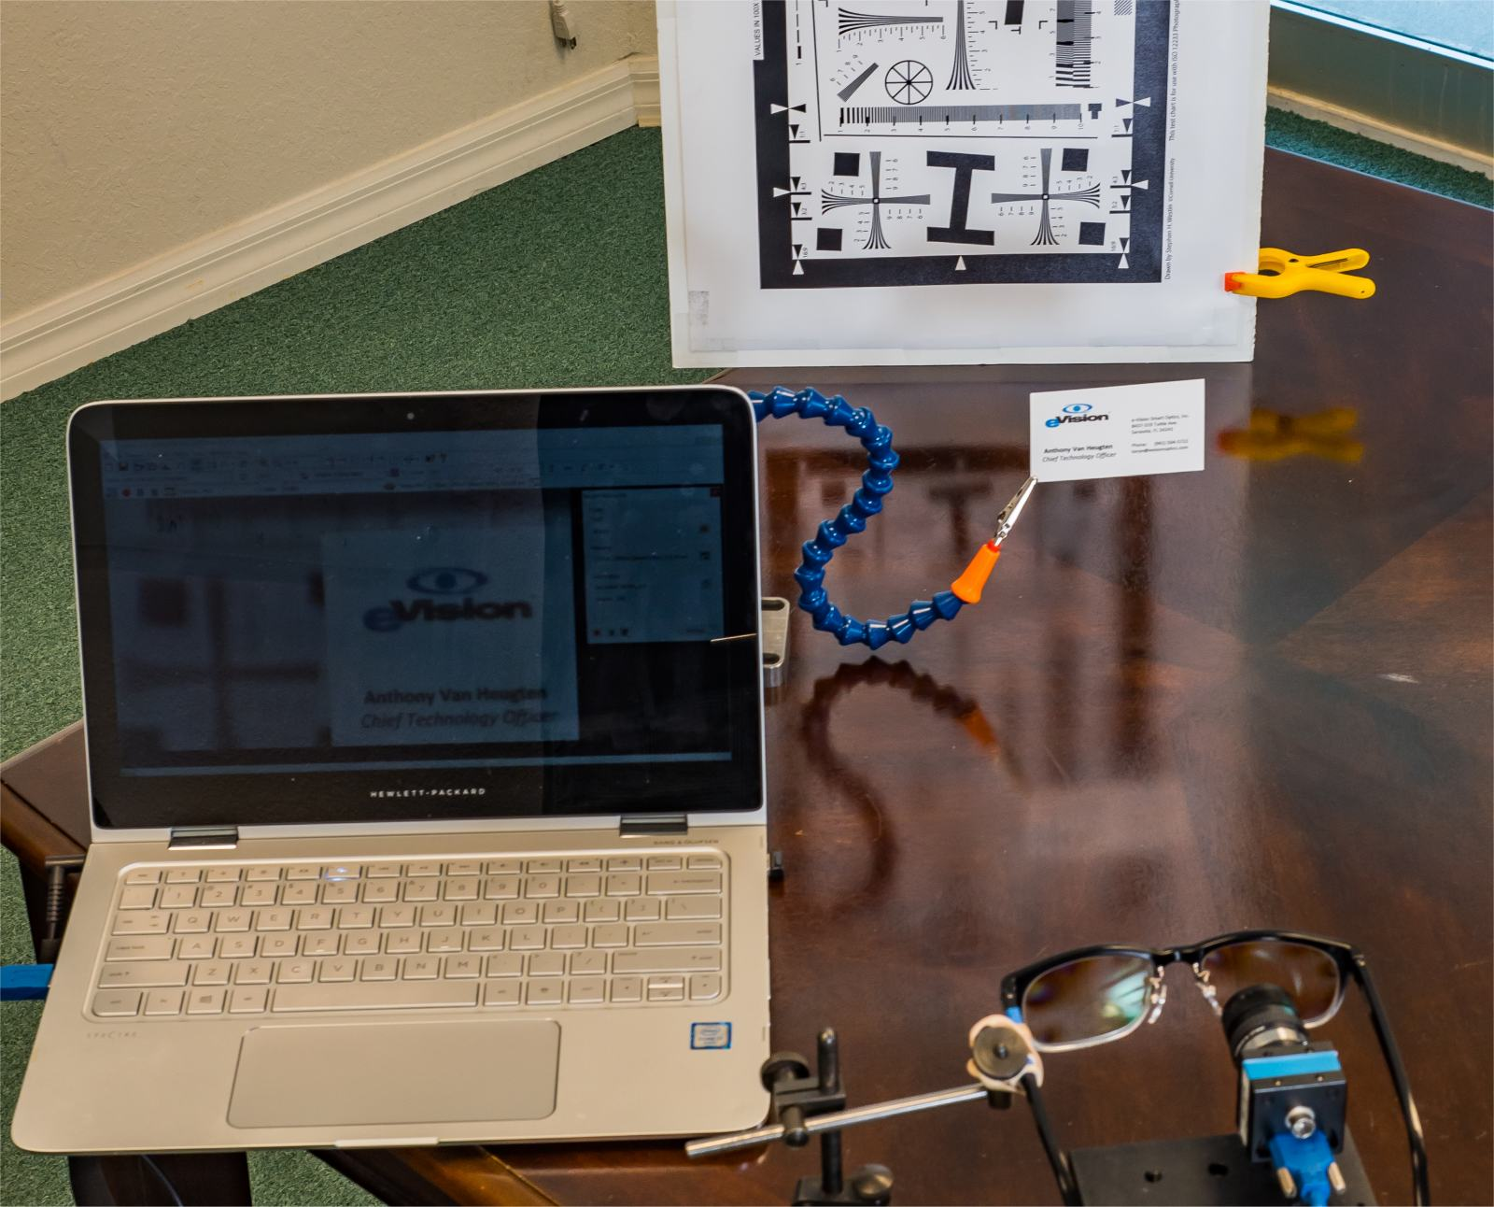
Spectacle Lens in Action
Slide 13: Spectacle Lens in Action

Slide 15
Spectacle Lens in Action
Slide 14: Spectacle Lens in Action

Slide 16
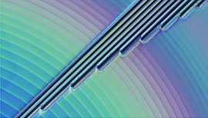
Electrode Based Spectacle Lenses
Slide 15: Electrode Based Spectacle Lenses
Currently in development
Two primary modes of operation +1.00 D and +2.50 D with tuneable focus
Uses photolithography to form electrode structure
Individual electrodes used to form a GRIN lens
To increase optical power phase resets are used
To minimize the amount of connections required ITO connections are used
30 mm lenses able to be fabricated

Slide 17
Vision Correction in Space
Slide 16: Vision Correction in Space
Visual impairment from intracranial pressure
First discovered when astronaut in the International Space Station saw Earth less clearly
Vision improved with reading glasses
Shift in vision towards farsightedness
Unpredictable during course of mission
One of the biggest challenges for the NASA Mission to Mars project
Spaceship engineering is only half the problem – humans aren’t built for space travel
Two potential show-stoppers for prolonged travel
Radiation exposure
Vision impairment from intracranial pressure (VIIP)
Current studies are only 6 months – Mars mission is 2-3 years
What is the cause of this vision deterioration?

Slide 18
Vision Correction in Space
Slide 17: Vision Correction in Space

Slide 19
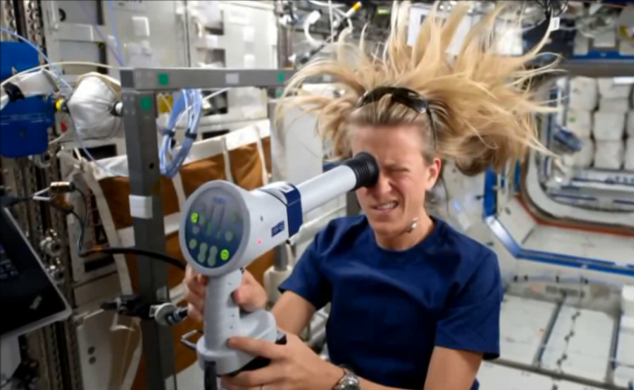
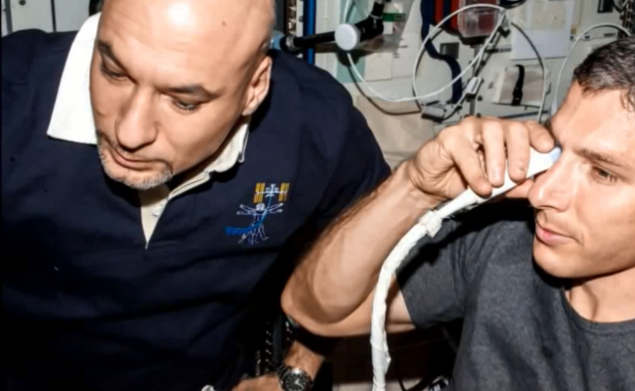
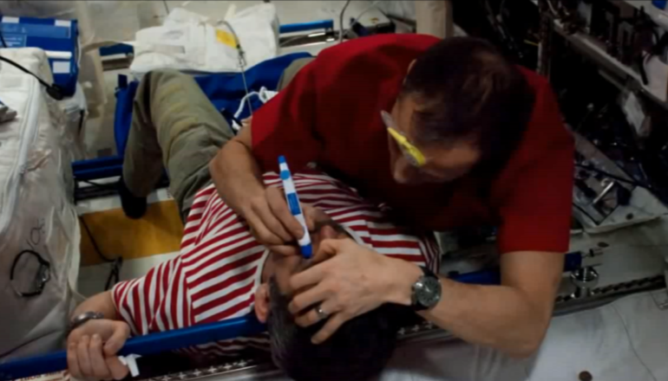
Vision Correction in Space
Slide 18: Vision Correction in Space
Best case is to prevent this from happening
Back-up plans are in effect to correct vision loss from VIIP
Back up plan is adjustable spectacles
Liquid crystal technology is capable of correcting multiple hyperopic shifts
Only a single optic is required, with the lens being able to be programmed inspace
eVision Smart Optics is currently working on this

Slide 20
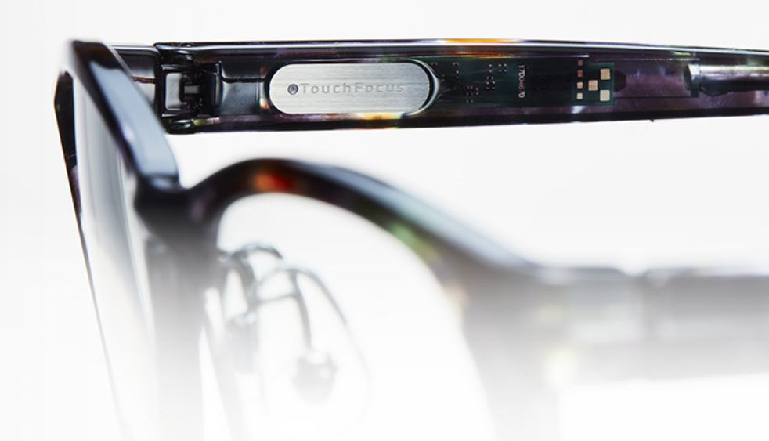
Summary and Conclusions
Slide 19: Summary and Conclusions
Liquid Crystal Lenses demonstrated solution for Presbyopia correction
Contact Lens Form
High quality optical devices formed using diffractive surface relief structure
Photoalignment improves optical performance
Up to +3.00 of optical power demonstrated
Tunability also demonstrated for intermediate vision correction
Spectacle Lens Form
Bifocal spectacle lenses already commercialized
Larger scale tunable lenses under development
30 mm lenses able to be fabricated using electrode based structures
Up to +2.50 D of tunable focus shown in large scale lenses

Slide 21
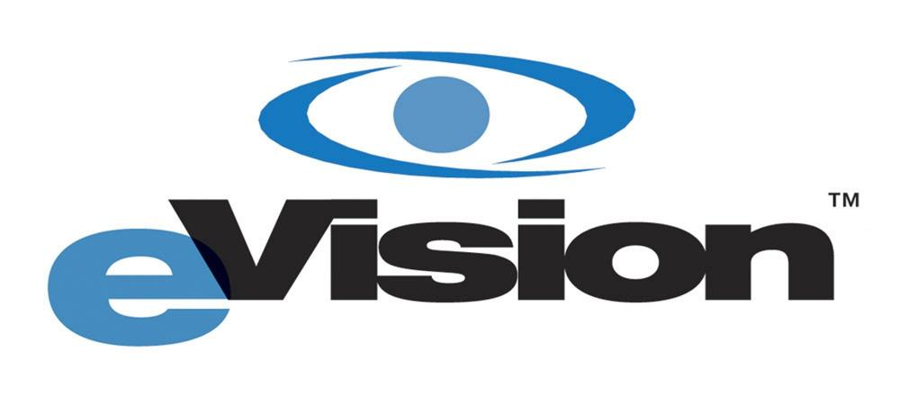
Thank you for Listening!
Slide 20: Finish
Contact Information:
Info@evisionoptics.com
Hmilton@evisionoptics.com
Website:
www.evisionoptics.com
Location:
1144 Tallevast Road, Sarasota, Florida, 34243, USA

